Slide 2

What A Church Should Expect From An Evangelist
Romans 10:13-15

Slide 3
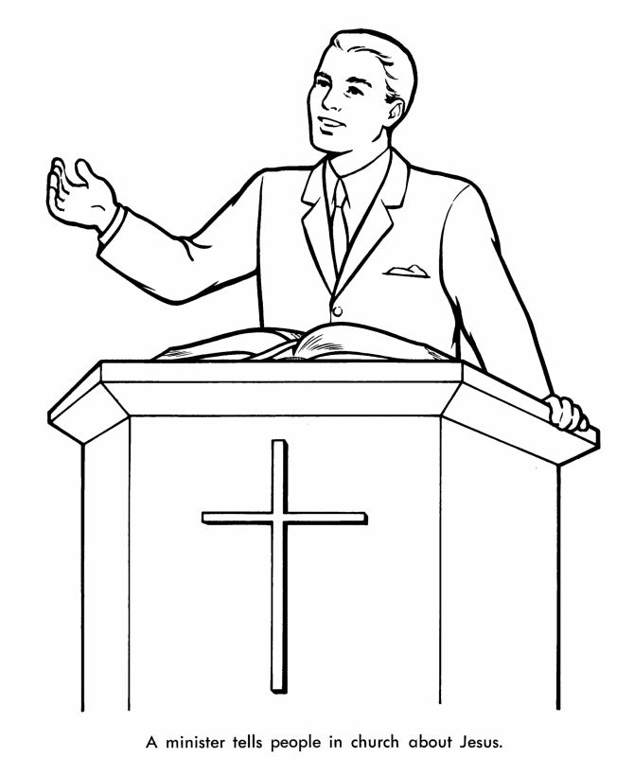
…have to
Positional
Must!

Slide 4

What Not To Expect:
Eloquence
Ear-tickling sermons
A walking Bible encyclopedia/ai
A 9 to 5 employee of the church (building)

Slide 5

You Should Expect:
A hard worker
A worker for the Lord:
Acknowledge the Lord
Strength from the Lord
Give credit to the Lord
Constant in prayer to the Lord
Speaks the Word of the Lord

Slide 6
You Should Expect:
A hard worker
A worker for the Lord
A properly-motivated worker
    Praise
    Money
    Sympathy
    Control
    Keep Brethren Off His Back
    Make Church Think He’s Indispensable

Slide 7
You Should Expect:
A hard worker
A worker for the Lord
A properly-motivated worker
    LOVE (1 Tim. 1:5)
      Love for the Lord
      Love for others (1 Thess. 2:19f)

Slide 8
What Not To Expect:
Eloquence
Ear-tickling sermons
A walking Bible encyclopedia
A 9 to 5 employee of the church (building)
God in the flesh
A mind reader

